Slide 1
Multiplexing Chapter 8

Slide 2
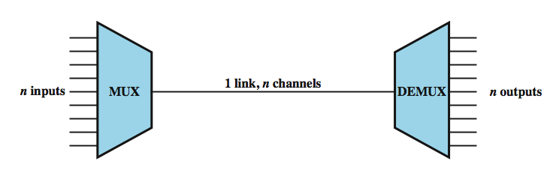
Multiplexing
multiple links on 1 physical line
common on long-haul, high capacity links
Forms of multiplexing: FDM, TDM-synchronous TDM, Statistical TDM
Notes:
To make efficient use of high-speed telecommunications lines, some form of multiplexing is used. Multiplexing allows several transmission sources to share a larger transmission capacity. A common application of multiplexing is in long-haul communications. Trunks on long-haul networks are high-capacity fiber, coaxial, or microwave links. These links can carry large numbers of voice and data transmissions simultaneously using multiplexing. Common forms of multiplexing are frequency division multiplexing (FDM), time division multiplexing (TDM), and statistical TDM (STDM).
Figure depicts the multiplexing function in its simplest form. There are n inputs to a multiplexer. The multiplexer is connected by a single data link to a demultiplexer. The link is able to carry n separate channels of data. The multiplexer combines (multiplexes) data from the n input lines and transmits over a higher-capacity data link. The demultiplexer accepts the multiplexed data stream, separates (demultiplexes) the data according to channel, and delivers data to the appropriate output lines.

Slide 3
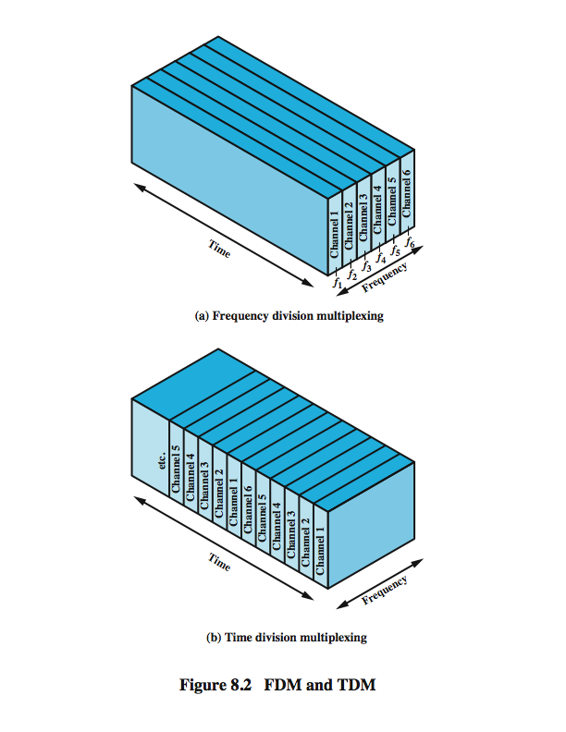
Frequency Division Multiplexing
Notes:
Frequency division multiplexing can be used with analog signals. A number of signals are carried simultaneously on the same medium by allocating to each signal a different frequency band. FDM is possible when the useful bandwidth of the transmission medium exceeds the required bandwidth of signals to be transmitted. A number of signals can be carried simultaneously if each signal is modulated onto a different carrier frequency and the carrier frequencies are sufficiently separated that the bandwidths of the signals do not significantly overlap. A general case of FDM is shown in Stallings DCC8e Figure 8.2a. Six signal sources are fed into a multiplexer, which modulates each signal onto a different frequency (f₁, …, f₆). Each modulated signal requires a certain bandwidth centered on its carrier frequency, referred to as a channel. To prevent interference, the channels are separated by guard bands, which are unused portions of the spectrum. The composite signal transmitted across the medium is analog. Note, however, that the input signals may be either digital or analog. In the case of digital input, the input signals must be passed through modems to be converted to analog. In either case, each input analog signal must then be modulated to move it to the appropriate frequency band.

Slide 4
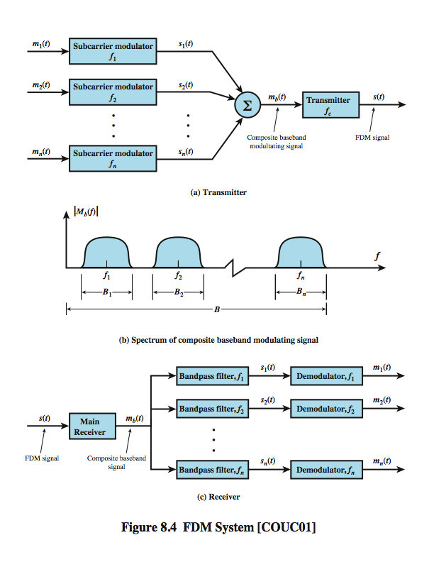
FDM System Overview
Notes:
A generic depiction of an FDM system is shown in Stallings DCC8e Figure 8.4. A number of analog or digital signals [m_{i}(t), i = 1, n] are to be multiplexed onto the same transmission medium. Modulation equipment is needed to move each signal to the required frequency band, and multiplexing equipment is needed to combine the modulated signals. Each signal m_{i}(t) is modulated onto a carrier f_{i}; because multiple carriers are to be used, each is referred to as a subcarrier. Any type of modulation may be used. The resulting analog, modulated signals are then summed to produce a composite baseband signal m_{b}(t). Figure 8.4b shows the result. The spectrum of signal m_{i}(t) is shifted to be centered on f_{i}. For this scheme to work, f_{i} must be chosen so that the bandwidths of the various signals do not significantly overlap. Otherwise, it will be impossible to recover the original signals. The composite signal may then be shifted as a whole to another carrier frequency by an additional modulation step. The FDM signal s(t) has a total bandwidth B = Sum B_{i} . This analog signal may be transmitted over a suitable medium. At the receiving end, the FDM signal is demodulated to retrieve m_{b}(t), which is then passed through n bandpass filters, each filter centered on f_{i} and having a bandwidth B_{i}, for 1 ≤ i ≤ n. In this way, the signal is again split into its component parts. Each component is then demodulated to recover the original signal.

Slide 5
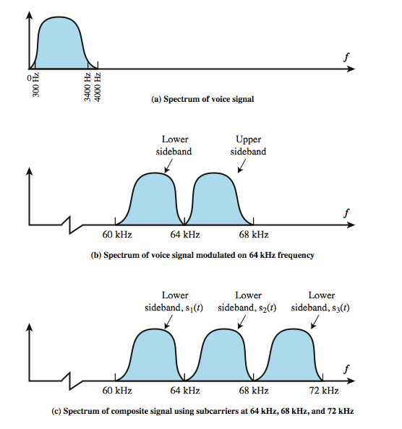
FDM Voiceband Example
Notes:
Stallings DCC8e Example 8.2 illustrates a simple example of transmitting three voice signals simultaneously over a medium. As was mentioned, the bandwidth of a voice signal is generally taken to be 4 kHz, with an effective spectrum of 300 to 3400 Hz (Figure 8.5a). If such a signal is used to amplitude-modulate a 64-kHz carrier, the spectrum of Figure 8.5b results. The modulated signal has a bandwidth of 8 kHz, extending from 60 to 68 kHz. To make efficient use of bandwidth, we elect to transmit only the lower sideband. If three voice signals are used to modulate carriers at 64, 68, and 72 kHz, and only the lower sideband of each is taken, the spectrum of Figure 8.5c results.
This figure points out two problems that an FDM system must cope with. The first is crosstalk, which may occur if the spectra of adjacent component signals overlap significantly. In the case of voice signals, with an effective bandwidth of only 3100 Hz (300 to 3400), a 4-kHz bandwidth is adequate. The spectra of signals produced by modems for voiceband transmission also fit well in this bandwidth. Another potential problem is intermodulation noise. On a long link, the nonlinear effects of amplifiers on a signal in one channel could produce frequency components in other channels.

Slide 6
Analog Carrier Systems
long-distance links use an FDM hierarchy
Used to transmit voiceband signals over high capacity transmission links.
Group- 1st level
12 voice channels (4kHz each) = 48kHz(Bandwidth)
in range 60kHz to 108kHz
Supergroup
FDM of 5 group signals supports 60 channels
on carriers between 420kHz to 612 kHz in increments of 48kHz.
Mastergroup
FDM of 10 supergroups supports 600 channels
Bandwidth of 2.52MHz.
so original signal can be modulated many times
Notes:
The long-distance carrier system provided in the United States and throughout the world is designed to transmit voiceband signals over high-capacity transmission links, such as coaxial cable and microwave systems. The earliest, and still a very common, technique for utilizing high-capacity links is FDM. In the United States, AT&T has designated a hierarchy of FDM schemes to accommodate transmission systems of various capacities. A similar, but unfortunately not identical, system has been adopted internationally under the auspices of ITU-T (Table 8.1).
At the first level of the AT&T hierarchy, 12 voice channels are combined to produce a group signal with a bandwidth of 12 × 4 kHz = 48 kHz, in the range 60 to 108 kHz. The next basic building block is the 60-channel supergroup, which is formed by frequency division multiplexing five group signals. The subcarriers have frequencies from 420 to 612 kHz in increments of 48 kHz. The resulting signal occupies 312 to 552 kHz. The next level of the hierarchy is the mastergroup, which combines 10 supergroup inputs. The mastergroup has a bandwidth of 2.52 MHz and can support 600 voice frequency (VF) channels.

Slide 7
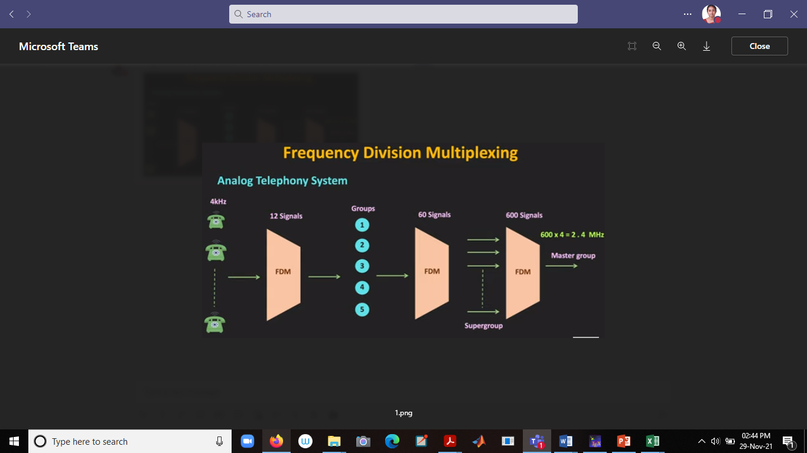

Slide 8
Wavelength Division Multiplexing
FDM with multiple beams of light at different wavelength.
carried over optical fiber links
commercial systems with 160 channels of 10 Gbps
lab demo of 256 channels 39.8 Gbps a total of 10.1Tbps over a 100Km space.
architecture similar to other FDM systems
multiplexer consolidates laser sources (1550nm) for transmission over single fiber
Optical amplifiers amplify all wavelengths spaced 10Km apart.
Demux separates channels at the destination
also have Dense Wavelength Division Multiplexing (DWDM) channel spacing of 200GHz or less.
Notes:
The true potential of optical fiber is fully exploited when multiple beams of light at different frequencies are transmitted on the same fiber. This is a form of frequency division multiplexing (FDM) but is commonly called wavelength division multiplexing (WDM). With WDM, the light streaming through the fiber consists of many colors, or wavelengths, each carrying a separate channel of data. Commercial systems with 160 channels of 10 Gbps are now available. In a lab environment, Alcatel has carried 256 channels at 39.8 Gbps each, a total of 10.1 Tbps, over a 100-km span.
A typical WDM system has the same general architecture as other FDM systems. A number of sources generate a laser beam at different wavelengths. Most WDM systems operate in the 1550-nm range. These are sent to a multiplexer, which consolidates the sources for transmission over a single fiber line. Optical amplifiers, typically spaced tens of kilometers apart, amplify all of the wavelengths simultaneously. Finally, the composite signal arrives at a demultiplexer, where the component channels are separated and sent to receivers at the destination point.
The term dense wavelength division multiplexing (DWDM) is often seen in the literature. There is no official or standard definition of this term. The term connotes the use of more channels, more closely spaced, than ordinary WDM. In general, a channel spacing of 200 GHz or less could be considered dense.

Slide 9
Synchronous Time Division Multiplexing
Notes:
Synchronous time division multiplexing can be used with digital signals or analog signals carrying digital data. In this form of multiplexing, data from various sources are carried in repetitive frames. Each frame consists of a set of time slots, and each source is assigned one or more time slots per frame. The effect is to interleave bits of data from the various sources. The interleaving can be at the bit level or in blocks of bytes or larger quantities. For example, the multiplexer in Stallings DCC8e Figure 8.2b has six inputs that might each be, say, 9.6 kbps. A single line with a capacity of at least 57.6 kbps (plus overhead capacity) could accommodate all six sources.
Synchronous TDM is called synchronous not because synchronous transmission is used, but because the time slots are preassigned to sources and fixed. The time slots for each source are transmitted whether or not the source has data to send.

Slide 10
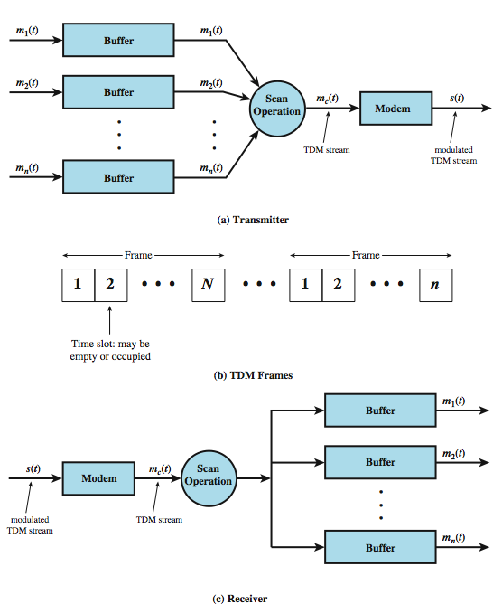
TDM System Overview
Notes:
A generic depiction of a synchronous TDM system is provided in Stallings DCC8e Figure 8.6. A number of signals [m_{i}(t), i = 1, n] are to be multiplexed onto the same transmission medium. The signals carry digital data and are generally digital signals. The incoming data from each source are briefly buffered. Each buffer is typically one bit or one character in length. The buffers are scanned sequentially to form a composite digital data stream m_{c}(t). The scan operation is sufficiently rapid so that each buffer is emptied before more data can arrive. Thus, the data rate of m_{c}(t) must at least equal the sum of the data rates of the m_{i}(t). The digital signal m_{c}(t) may be transmitted directly, or passed through a modem so that an analog signal is transmitted. In either case, transmission is typically synchronous.
The transmitted data may have a format something like Figure 8.6b. The data are organized into frames. Each frame contains a cycle of time slots. In each frame, one or more slots are dedicated to each data source. The sequence of slots dedicated to one source, from frame to frame, is called a channel. The slot length equals the transmitter buffer length, typically a bit or a byte (character).
At the receiver, the interleaved data are demultiplexed and routed to the appropriate destination buffer. For each input source m_{i}(t), there is an identical output destination that will receive the output data at the same rate at which it was generated.

Slide 11
TDM Link Control
no headers and trailers
data link control protocols not needed
flow control
data rate of multiplexed line is fixed
if one channel receiver can not receive data, the others must carry on
leaving empty slots
error control
errors detected & handled on individual channel
Notes:
Note that the transmitted data stream depicted in Stallings DCC8e Figure 8.6b does not contain the headers and trailers that we have come to associate with synchronous transmission, as the control mechanisms provided by a data link protocol are not needed. It should be clear that, as far as the multiplexer and demultiplexer (Figure 8.1) are concerned, flow control is not needed. The data rate on the multiplexed line is fixed, and the multiplexer and demultiplexer are designed to operate at that rate. If one of the individual output lines attaches to a device that is temporarily unable to accept data, transmission must continue, since the remaining output lines are expecting to receive data at predetermined times. Thus, the channel in question will carry empty slots, but the frames as a whole will maintain the same transmission rate.
The reasoning for error control is the same. It would not do to request retransmission of an entire TDM frame because an error occurs on one channel. The devices using the other channels do not want a retransmission nor would they know that a retransmission has been requested by some other device on another channel. Again, the solution is to apply error control on a per-channel basis.

Slide 12
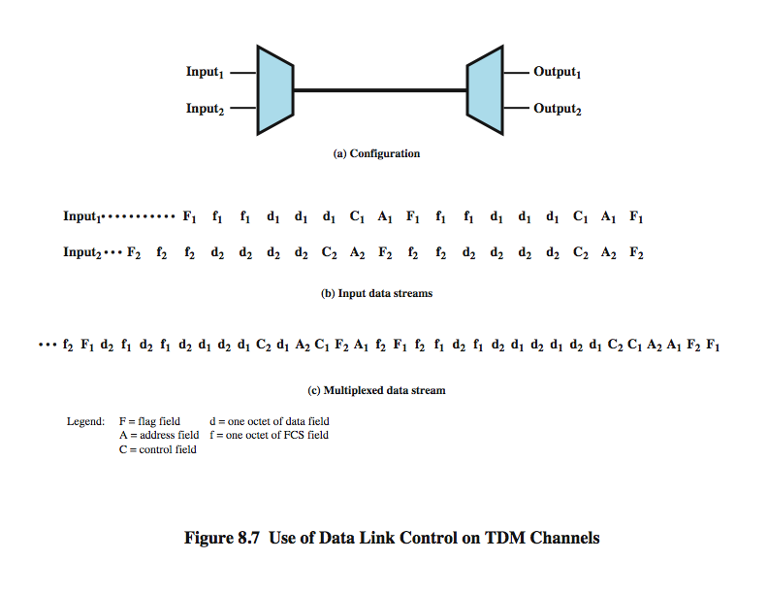
Data Link Control on TDM
Notes:
Flow control and error control can be provided on a per-channel basis by using a data link control protocol such as HDLC on a per-channel basis. A simplified example is shown in Stallings DCC8e Figure 8.7. Assume two data sources, each using HDLC. One is transmitting a stream of HDLC frames containing three octets of data each, and the other is transmitting HDLC frames containing four octets of data. For clarity, we assume that character-interleaved multiplexing is used, although bit interleaving is more typical. The octets of the HDLC frames from the two sources are shuffled together for transmission over the multiplexed line. Note that even though the HDLC frames have lost their integrity in some sense, the pieces are reassembled correctly before they are seen by the device on the other end of the HDLC protocol. In this sense, the multiplexing/demultiplexing operation is transparent to the attached stations; to each communicating pair of stations, it appears that they have a dedicated link.
One refinement is needed in this figure. Both ends of the line need to be a combination multiplexer/demultiplexer with a full-duplex line in between. Then each channel consists of two sets of slots, one traveling in each direction. The individual devices attached at each end can, in pairs, use HDLC to control their own channel. The multiplexer/demultiplexers need not be concerned with these matters.

Slide 13
Framing
no flag or SYNC characters bracketing TDM frames
must still provide synchronizing mechanism between source and destination
Added- digit framing
one control bit added to each TDM frame
identifiable bit pattern used on control channel
eg. alternating 01010101…
compare incoming bit patterns on each channel with known sync pattern
Notes:
See that a link control protocol is not needed to manage the overall TDM link. There is, however, a basic requirement for framing. Because we are not providing flag or SYNC characters to bracket TDM frames, some means is needed to assure frame synchronization. It is clearly important to maintain framing synchronization because, if the source and destination are out of step, data on all channels are lost.
Perhaps the most common mechanism for framing is known as added-digit framing. In this scheme, typically, one control bit is added to each TDM frame. An identifiable pattern of bits, from frame to frame, is used as a "control channel." A typical example is the alternating bit pattern, 101010…. This is a pattern unlikely to be sustained on a data channel. Thus, to synchronize, a receiver compares the incoming bits of one frame position to the expected pattern. If the pattern does not match, successive bit positions are searched until the pattern persists over multiple frames. Once framing synchronization is established, the receiver continues to monitor the framing bit channel. If the pattern breaks down, the receiver must again enter a framing search mode.

Slide 14
Pulse Stuffing
have problem of synchronizing data sources
with clocks in different sources drifting
Pulse Stuffing a common solution
have outgoing data rate (excluding framing bits) higher than sum of incoming rates
stuff extra dummy bits or pulses into each incoming signal until it matches local clock
stuffed pulses inserted at fixed locations in frame and removed at demultiplexer
Notes:
Perhaps the most difficult problem in the design of a synchronous time division multiplexer is that of synchronizing the various data sources. If each source has a separate clock, any variation among clocks could cause loss of synchronization. Also, in some cases, the data rates of the input data streams are not related by a simple rational number. For both these problems, a technique known as pulse stuffing is an effective remedy. With pulse stuffing, the outgoing data rate of the multiplexer, excluding framing bits, is higher than the sum of the maximum instantaneous incoming rates. The extra capacity is used by stuffing extra dummy bits or pulses into each incoming signal until its rate is raised to that of a locally generated clock signal. The stuffed pulses are inserted at fixed locations in the multiplexer frame format so that they may be identified and removed at the demultiplexer.

Slide 15
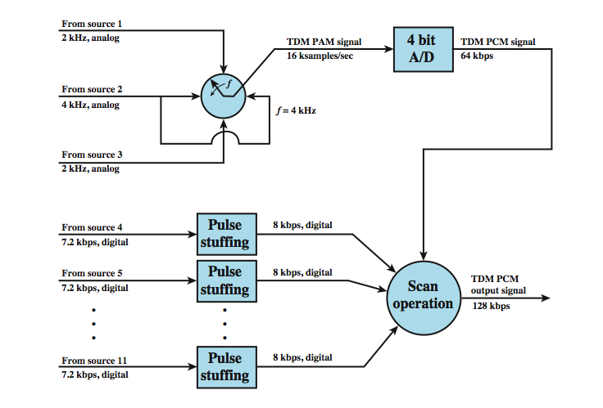
TDM Example
Notes:
Example 8.3 illustrates the use of synchronous TDM to multiplex digital and analog sources (Figure 8.8). Consider that there are 11 sources to be multiplexed on a single link: Source 1: Analog, 2-kHz bandwidth, Source 2: Analog, 4-kHz bandwidth, Source 3: Analog, 2-kHz bandwidth, Sources 4-11: Digital, 7200 bps synchronous
As a first step, the analog sources are converted to digital using PCM. Recall from Chapter 5 that PCM is based on the sampling theorem, which dictates that a signal be sampled at a rate equal to twice its bandwidth. Thus, the required sampling rate is 4000 samples per second for sources 1 and 3, and 8000 samples per second for source 2. These samples, which are analog (PAM), must then be quantized or digitized. Let us assume that 4 bits are used for each analog sample. For convenience, these three sources will be multiplexed first, as a unit. At a scan rate of 4 kHz, one PAM sample each is taken from sources 1 and 3, and two PAM samples are taken from source 2 per scan. These four samples are interleaved and converted to 4-bit PCM samples. Thus, a total of 16 bits is generated at a rate of 4000 times per second, for a composite bit rate of 64 kbps. For the digital sources, pulse stuffing is used to raise each source to a rate of 8 kbps, for an aggregate data rate of 64 kbps. A frame can consist of multiple cycles of 32 bits, each containing 16 PCM bits and two bits from each of the eight digital sources.

Slide 16
Digital Carrier Systems
long-distance links use an TDM hierarchy
AT&T (USA) and ITU-T (International) variants
US system based on DS-1 format
can carry mixed voice and data signals
24 channels used for total data rate of 1.544Mbps
each voice channel contains one word of digitized data (PCM, 8000 samples per sec)
same format for 56kbps digital data
can interleave DS-1 channels for higher rates
DS-2 is four DS-1 at 6.312Mbps

Slide 17
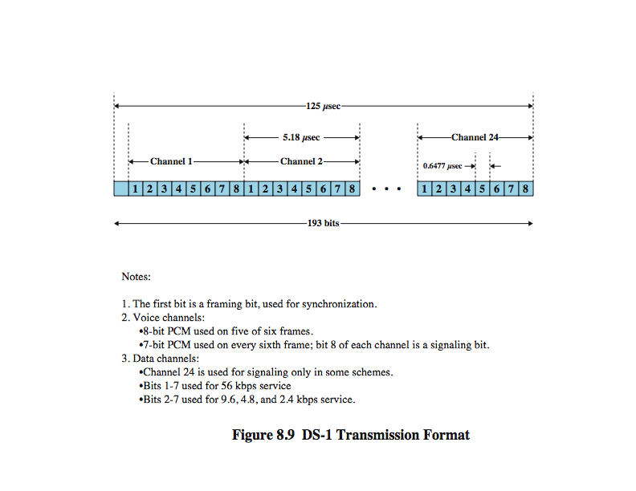
DS-1 Transmission Format

Slide 18
Statistical TDM
in Synch TDM many slots are wasted
Statistical TDM allocates time slots dynamically based on demand
multiplexer scans input lines and collects data until frame full
line data rate lower than aggregate input line rates
may have problems during peak periods
must buffer inputs
Notes:
In a synchronous time division multiplexer, many of the time slots in a frame are often wasted. Statistical time division multiplexing provides a generally more efficient service than synchronous TDM for the support of terminals. With statistical TDM, time slots are not preassigned to particular data sources. Rather, user data are buffered and transmitted as rapidly as possible using available time slots. As with a synchronous TDM, the statistical multiplexer has a number of I/O lines on one side and a higher speed multiplexed line on the other. Each I/O line has a buffer associated with it. In the case of the statistical multiplexer, there are n I/O lines, but only k, where k < n, time slots available on the TDM frame. For input, the function of the multiplexer is to scan the input buffers, collecting data until a frame is filled, and then send the frame. On output, the multiplexer receives a frame and distributes the slots of data to the appropriate output buffers. Because statistical TDM takes advantage of the fact that the attached devices are not all transmitting all of the time, the data rate on the multiplexed line is less than the sum of the data rates of the attached devices. Thus, a statistical multiplexer can use a lower data rate to support as many devices as a synchronous multiplexer. However there is more overhead per slot for statistical TDM because each slot carries an address as well as data. The difficulty with this approach is that, while the average aggregate input may be less than the multiplexed line capacity, there may be peak periods when the input exceeds capacity. The solution to this problem is to include a buffer in the multiplexer to hold temporary excess input. There is a tradeoff between the size of the buffer used and the data rate of the line. We would like to use the smallest possible buffer and the smallest possible data rate, but a reduction in one requires an increase in the other.

Slide 19
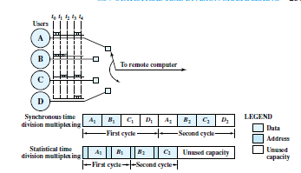

Slide 20
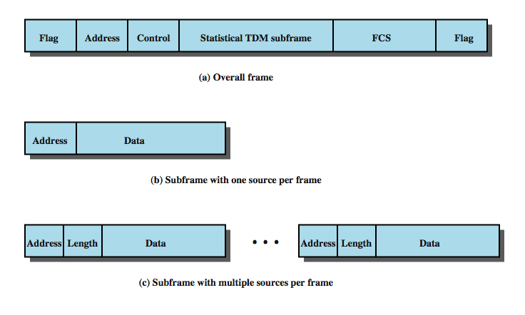
Statistical TDM Frame Format
Notes:
The frame structure used by a statistical multiplexer has an impact on performance. Clearly, it is desirable to minimize overhead bits to improve throughput. Stallings DCC8e Figure 8.13 shows two possible formats. In the first case, only one source of data is included per frame. That source is identified by an address. The length of the data field is variable, and its end is marked by the end of the overall frame. This scheme can work well under light load but is quite inefficient under heavy load. A way to improve efficiency is to allow multiple data sources to be packaged in a single frame. Now, however, some means is needed to specify the length of data for each source. Thus, the statistical TDM subframe consists of a sequence of data fields, each labeled with an address and a length. Several techniques can be used to make this approach even more efficient. The address field can be reduced by using relative addressing, which specifies the number of the current source relative to the previous source, modulo the total number of sources. Another refinement is to use a 2-bit label with the length field. A value of 00, 01, or 10 corresponds to a data field of 1, 2, or 3 bytes; no length field is necessary. A value of 11 indicates that a length field is included. Yet another approach is to multiplex one character from each data source that has a character to send in a single data frame. In this case the frame begins with a bit map that has a bit length equal to the number of sources. For each source that transmits a character during a given frame, the corresponding bit is set to one.

Slide 21
Asymmetrical Digital Subscriber Line (ADSL)
link between subscriber and network
uses currently installed twisted pair cable
is Asymmetric – larger capacity for downstream than up stream
uses Frequency division multiplexing
reserve lowest 25kHz for voice (POTS-plain old telephone service)
uses echo cancellation or FDM to give two bands
has a range of up to 5.5km
Notes:
In the implementation and deployment of a high-speed wide area public digital network, the most challenging part is the link between subscriber and network: the digital subscriber line. ADSL is the most widely publicized of a family of new modem technologies designed to provide high-speed digital data transmission over ordinary telephone wire. The term asymmetric refers to the fact that ADSL provides more capacity downstream (from the carrier’s central office to the customer’s site) than upstream (from customer to carrier), being a good fit to Internet requirements. ADSL uses frequency division multiplexing (FDM) in a novel way to exploit the 1-MHz capacity of twisted pair. When echo cancellation is used, the entire frequency band for the upstream channel overlaps the lower portion of the downstream channel. The ADSL scheme provides a range of up to 5.5 km, depending on the diameter of the cable and its quality.

Slide 22
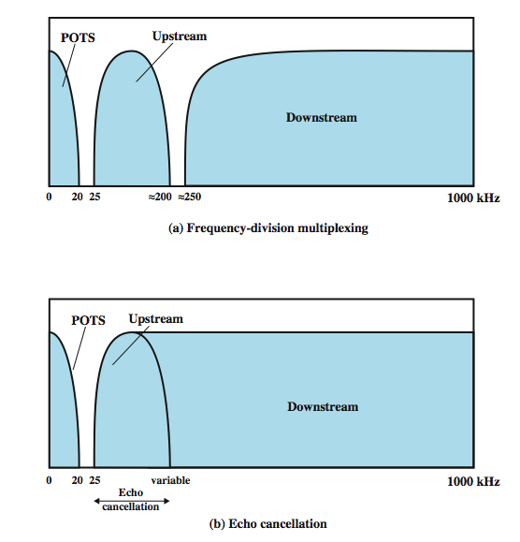
ADSL Channel Configuration
Notes:
ADSL uses frequency division multiplexing (FDM). There are three elements of the ADSL strategy, shown above in Stallings DCC8e Figure 8.17:
• Reserve lowest 25 kHz for voice (POTS - plain old telephone service). The voice is carried only in the 0 to 4 kHz band; the additional bandwidth is to prevent crosstalk between the voice and data channels.
• Use either echo cancellation or FDM to allocate two bands, a smaller upstream band and a larger downstream band. Echo cancellation is a signal processing technique that allows transmission of digital signals in both directions on a single transmission line simultaneously. In essence, a transmitter must subtract the echo of its own transmission from the incoming signal to recover the signal sent by the other side.
• Use FDM within the upstream and downstream bands. In this case, a single bit stream is split into multiple parallel bit streams and each portion is carried in a separate frequency band.
When echo cancellation is used, the entire frequency band for the upstream channel overlaps the lower portion of the downstream channel. This has two advantages compared to the use of distinct frequency bands for upstream and downstream: the higher the frequency, the greater the attenuation., and echo cancellation design is more flexible for changing upstream capacity. The disadvantage of the use of echo cancellation is the need for echo cancellation logic on both ends of the line.

Slide 23
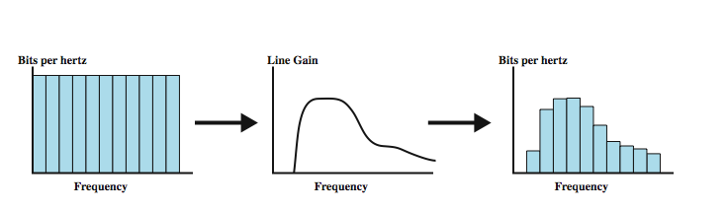
Discrete Multitone (DMT)
multiple carrier signals at different frequencies
divide into 4kHz subchannels
test and use subchannels with better SNR
256 downstream subchannels at 4kHz (60kbps)
in theory 15.36Mbps, in practice 1.5-9Mbps
Notes:
Discrete multitone (DMT) uses multiple carrier signals at different frequencies, sending some of the bits on each channel. The available transmission band (upstream or downstream) is divided into a number of 4-kHz subchannels. On initialization, the DMT modem sends out test signals on each subchannel to determine the signal-to-noise ratio (SNR). The modem then assigns more bits to channels with better signal transmission qualities and less bits to channels with poorer signal transmission qualities. Stallings DCC8e Figure 8.18 illustrates this process. Each subchannel can carry a data rate of from 0 to 60 kbps. The figure shows a typical situation in which there is increasing attenuation and hence decreasing signal-to-noise ratio at higher frequencies. As a result, the higher-frequency subchannels carry less of the load. Present ADSL/DMT designs employ 256 downstream subchannels. In theory, with each 4-kHz subchannel carrying 60 kbps, it would be possible to transmit at a rate of 15.36 Mbps. In practice, transmission impairments prevent attainment of this data rate. Current implementations operate at from 1.5 to 9 Mbps, depending on line distance and quality.

Slide 24
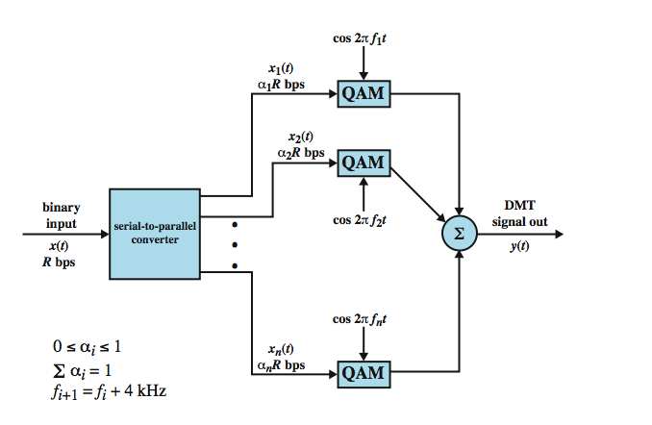
DMT Transmitter
Notes:
Stallings DCC8e Figure 8.19 provides a general block diagram for DMT transmission. After initialization, the bit stream to be transmitted is divided into a number of substreams, one for each subchannel that will carry data. The sum of the data rates of the substreams is equal to the total data rate. Each substream is then converted to an analog signal using quadrature amplitude modulation (QAM), described in Chapter 5. This scheme works easily because of QAM’s ability to assign different numbers of bits per transmitted signal. Each QAM signal occupies a distinct frequency band, so these signals can be combined by simple addition to produce the composite signal for transmission.

